Slide 1

OpenSCAP Workshop
Hands-on Labs to explore Scanning, Reporting, Remediation
Shawn Wells
shawn@redhat.com || 443-534-0130 (US EST)

Slide 2
What’s the latest in the Linux Security Automation space?
Government & Commercial Initiatives
Formal and Emerging SCAP Standards
What tools and content are available today?
For enumerating (known) software vulnerabilities
For assessing configuration

Slide 3
In the next 2 hours . . .
Install and review compliance profiles in RHEL 7
Perform and interpret compliance scans, then remediate findings
Create custom (derived) configuration baseline with SCAP Workbench
RHEL 7 “Easy Button” Installations
Introspectively scan Linux containers
_______________________________
Notes:
Why are we here?
To be able to mitigate consequences of possible attack, the assets at risk must be recognized prior to the attack.
To properly implement security guidance, target computers need to be hardened and continuously monitored during their lifecycle.
The major focus of this work is to accommodate compliance audit in large infrastructure deployments using open source software.
The objective is to enable users to perform the security audit on multiple remote systems from a single, centralized environments.

Slide 4
MOTIVATION
RHEL5 STIG
587 compliance items
Many are manual
Avg Time to Configure & Verify Setting | # controls | Total Time per RHEL instance
1 minute | * 587 | 9.7 hours
3 minutes | * 587 | 29.4 hours
5 minutes | * 587 | 48.9 hours

Slide 5
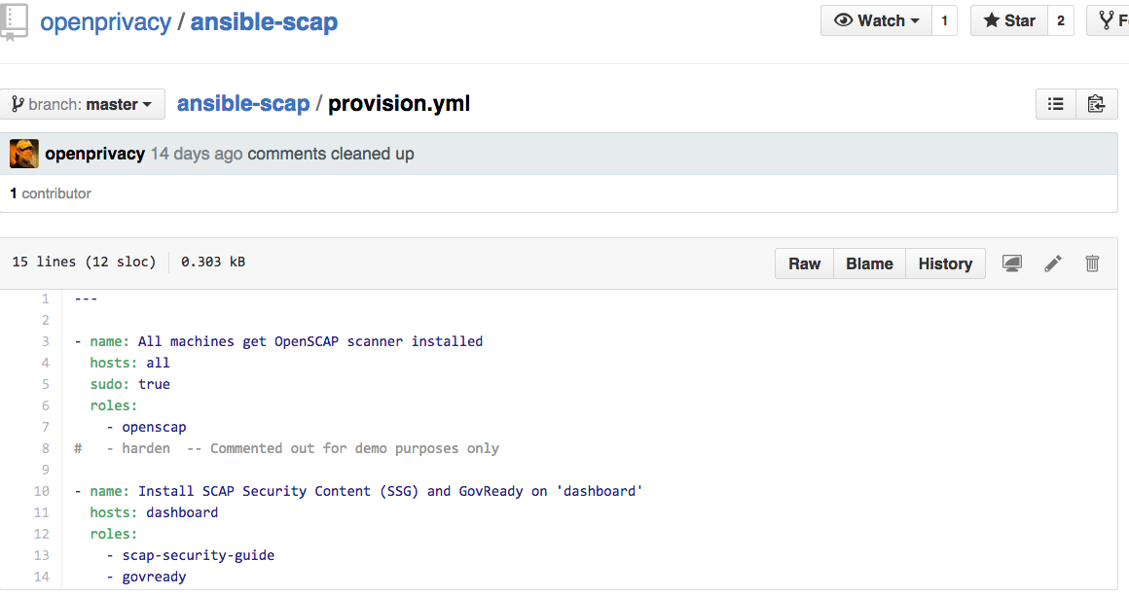

Slide 6
… or a single LOC in kickstart
$ oscap xccdf eval
--profile rhel7-stig
--remediate
--report /root/scan-report.html
/usr/share/xml/scap/content.xml

Slide 7
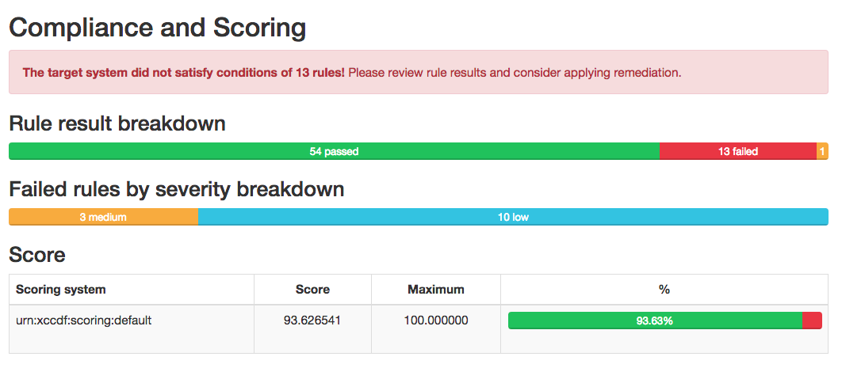

Slide 8
Intro to SCAP

Slide 9
First, an SCAP Primer
A family of specifications managed by NIST
Really a bunch of XML schema
which are data formats
so not a protocol at all, it turns out
openly defined, community developed, and evolving

Slide 10
First, an SCAP Primer
Defines standardized formats
Because you’ll get:
Standardized inputs (e.g. a compliance baseline)
Standardized outputs (e.g. compliance report)
Provides the enterprise liberty with regard to product choices
Avoid vendor lock-in
Federal procurement language starting to require SCAP

Slide 11
TOOLS
vs
CONTENT

Slide 12
U.S. Gov SCAP Validation Program https://scap.nist.gov/validation/
Automated test suites to verify interpreters, like OpenSCAP
Mandated by US Gov: The U.S. Office of Management and Budget has required, in the August 11, 2008, M-08-22 memorandum to Federal CIOs, that "Both industry and government information technology providers must use SCAP validated tools with FDCC Scanner capability to certify their products operate correctly with FDCC configurations and do not alter FDCC settings. Agencies will use SCAP tools to scan for both FDCC configurations and configuration deviations approved by department or agency accrediting authority. Agencies must also use these tools when monitoring use of these configurations as part of FISMA continuous monitoring."
Required by GSA for vulnerability and configuration management products

Slide 13
U.S. Gov SCAP Validation Program
Also covers content (reference: NIST SP 800-70)
Tier | Machine Readable? | Automated Format? | References to Security Compliance Framework?
1 | No | N/A | Optional
2 | Yes | Non-standard (proprietary, product-specific, etc) | Optional
3 | Yes | Complete SCAP-expressed checklist that should run in SCAP-enabled products and pass through SCAPVal with no errors | Optional
4 | Yes | Tier III + Includes low-level security enumerations that map to high-level security requirements (e.g. SP 800-53 controls) | Required; must be vetted with at least one governance organization authoritative for the security compliance framework.

Slide 14
ACRONYM BREAKDOWN

Slide 15
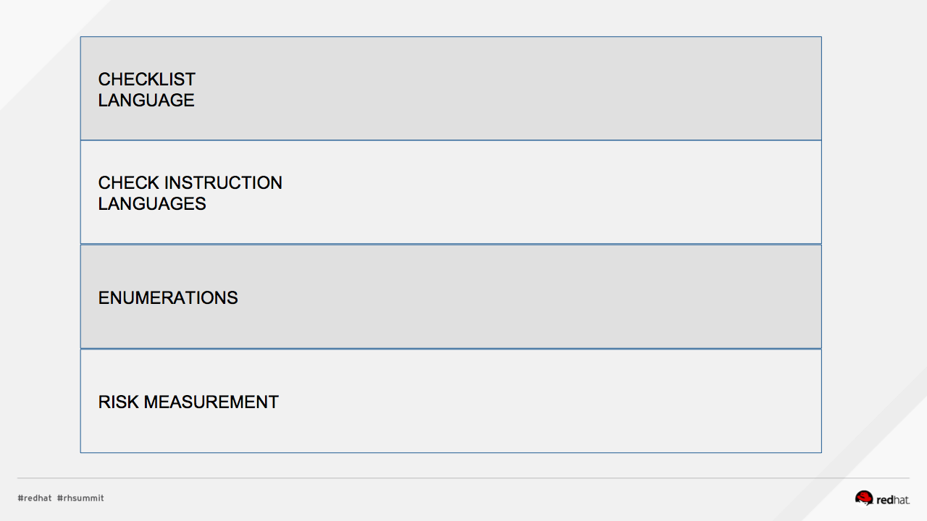

Slide 16
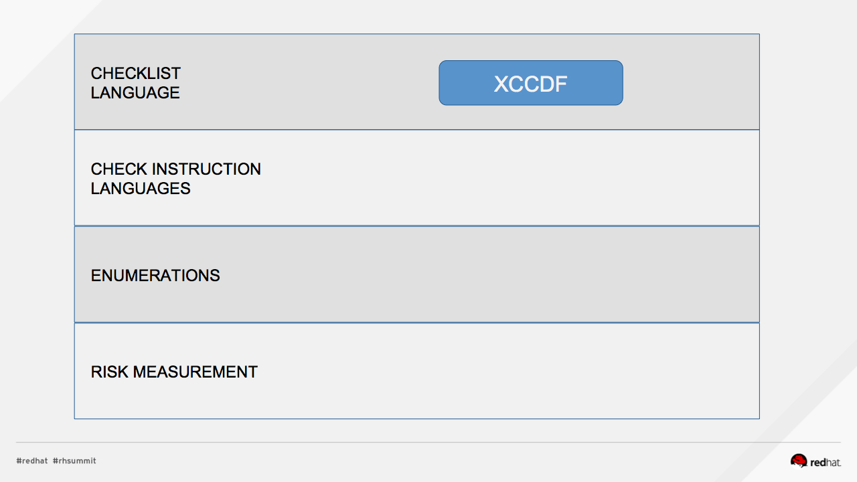

Slide 17
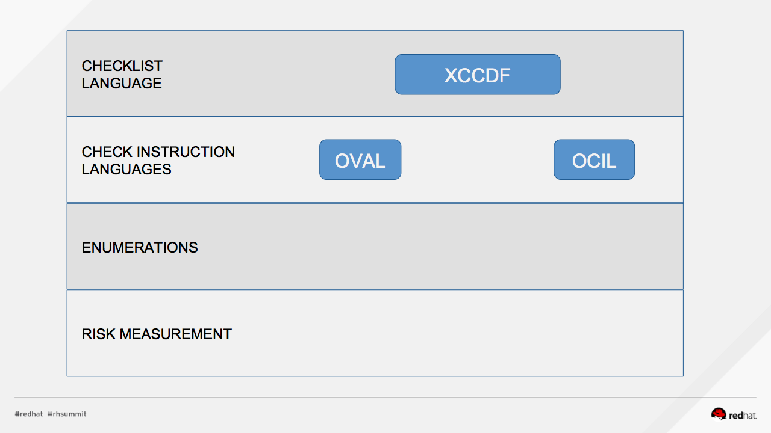

Slide 18
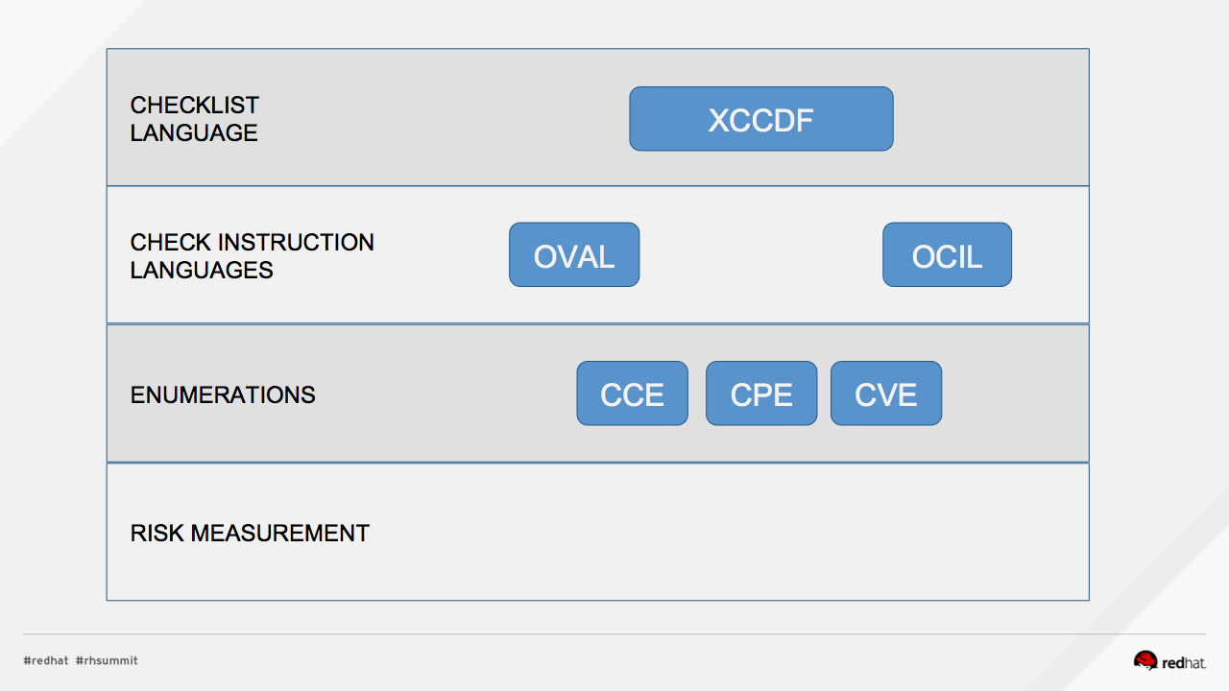

Slide 19
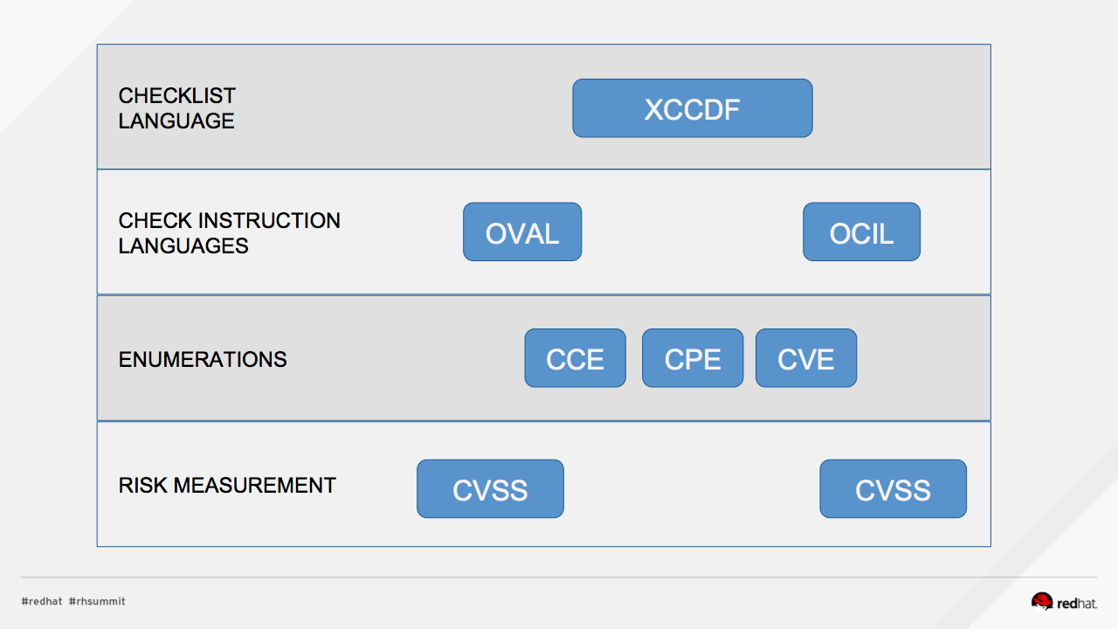

Slide 20
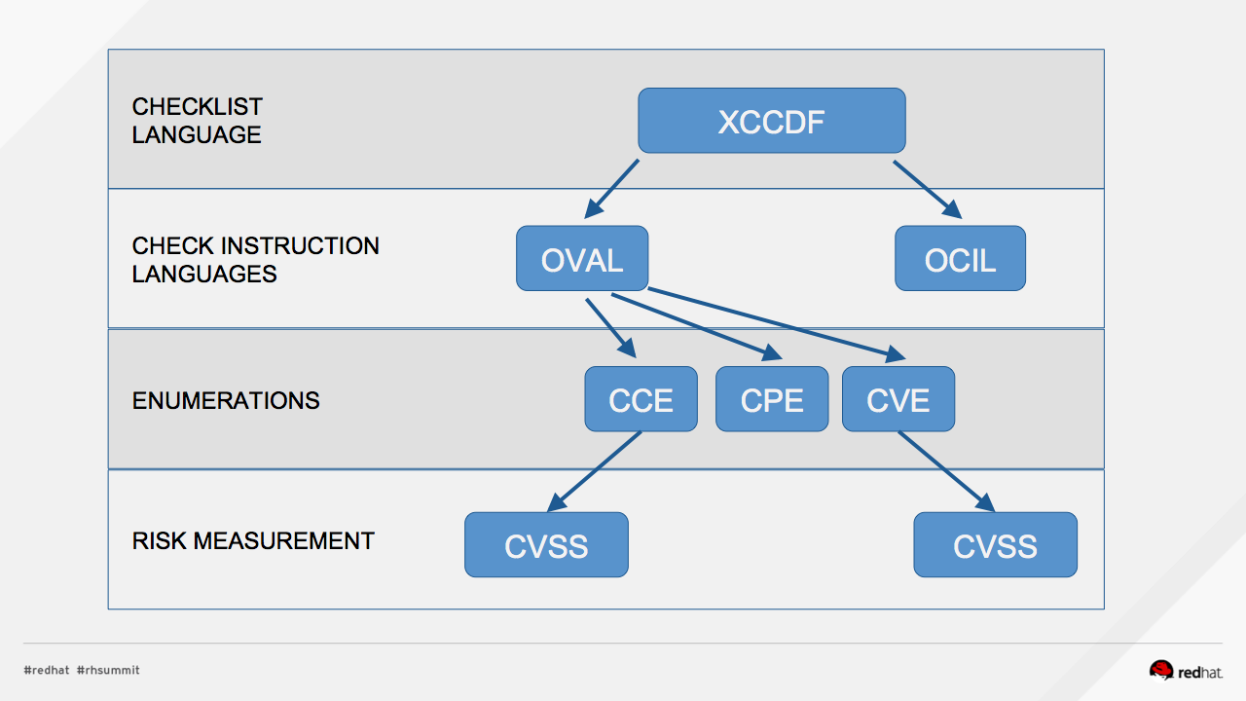

Slide 21
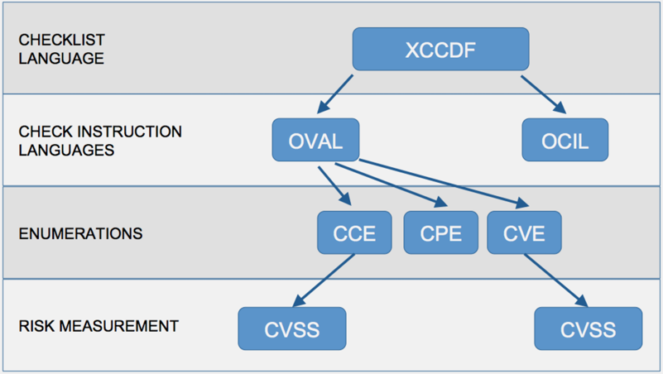
Pop Quiz!
What assurances do I have that CVSS scores are accurate?
Who assigns CCEs?
Who reviews the CCE to NIST mappings?

Slide 22
OPEN SOURCE
CONFRONTS THE C&A CHALLENGE:
OpenSCAP

Slide 23

Community created portfolio of tools and content to assess systems for known vulnerabilities. https://github.com/OpenSCAP

Slide 24

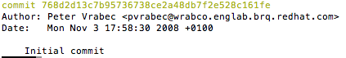
2008 | First commit to OpenSCAP, execution capability for SCAP on Linux

Slide 25
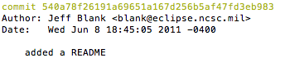
2008 | First commit to OpenSCAP, execution capability for SCAP on Linux
2011 | First commit to SCAP Security Guide, hardening guidance + policy references Colloquially, “SCAP Content”

Slide 26


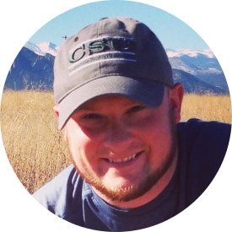
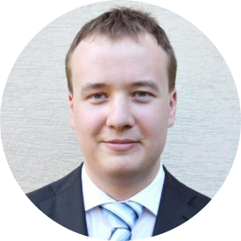



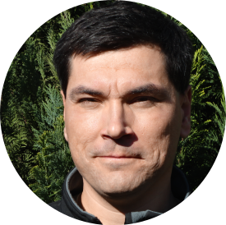



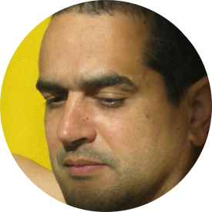
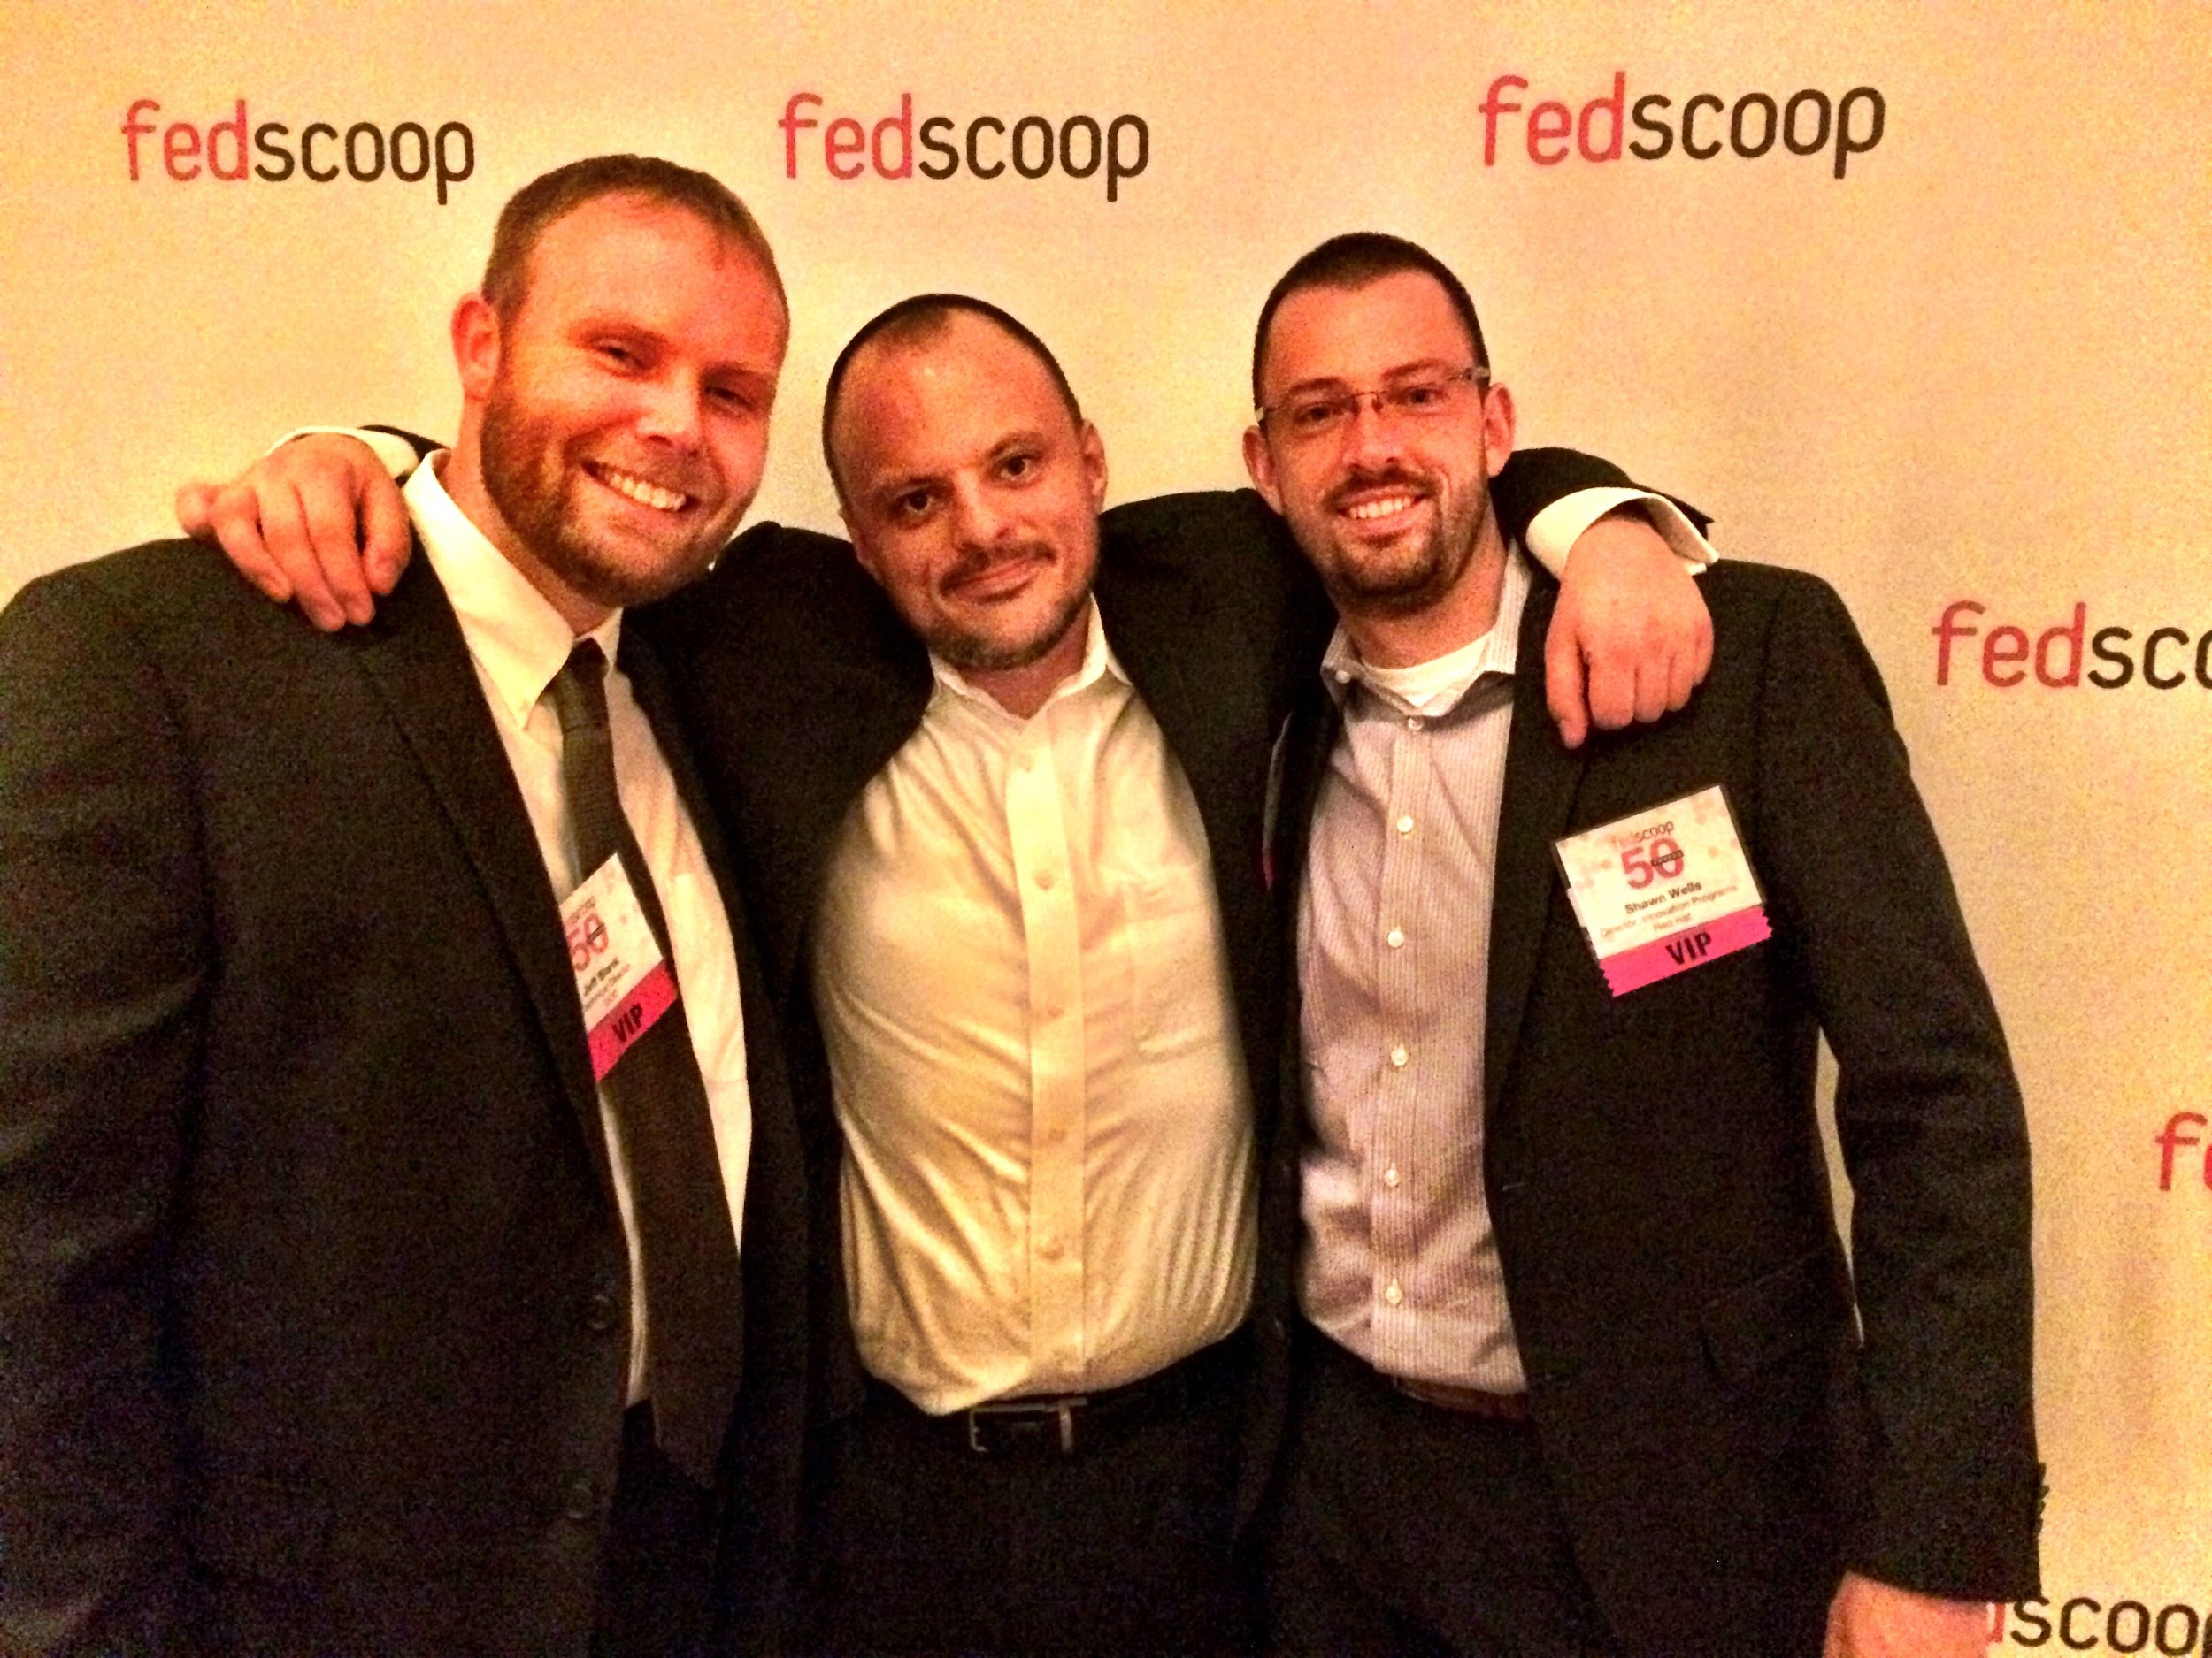











Slide 27
Power of the Community
RHEL7 STIG content, rebased in RHEL 7.3, reflects . . .
6,180 commits from 95 people
441,055 lines of code
OpenSCAP interpreter contains . . .
6,811 commits from 74 people
157,775 lines of code
“Security Button” in RHEL7 installer
6 people, 90 days, 6,806 lines of code

Slide 28
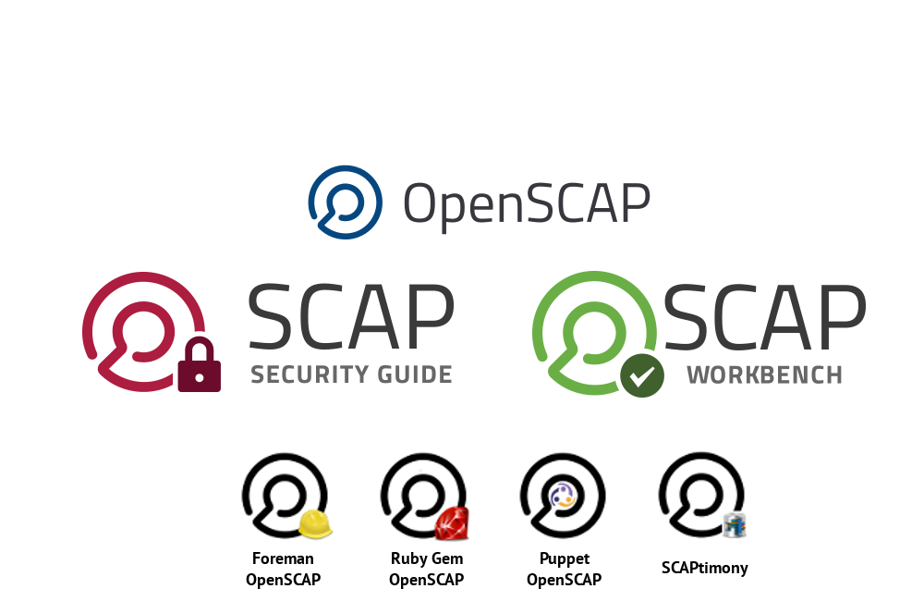

Slide 29
Keyboard Time!

Slide 30
Step 1: Download SSH keys http://studentX.labs.redhatgov.io
Step 2: Login $ ssh -i <key> ec2-user@studentX.labs.redhatgov.io
Step 3: Sudo to root $ sudo bash

Slide 31
#1: INSTALL, REVIEW PROFILES
Install OpenSCAP and SCAP Content
$ sudo yum -y install openscap-scanner scap-security-guide What default profiles exist? $ oscap info /usr/share/xml/scap/ssg/content/ssg-rhel7-xccdf.xml ….
Profiles:
pci-dss
rht-ccp
common
stig-rhel7-server-upstream (p.s., we’re changing that super long /usr/share/xml/… path in rhel 7.4)

Slide 32
#2: REVIEW HARDENING GUIDES
Review manpage
$ man scap-security-guide
Pop Quiz: Where are the files for the HTML guides located?
For the workshop: http://studentX.labs.redhatgov.io → click on “SSG Docs” we copied the files for easy viewing

Slide 33
#3: REVIEW POLICY MAPPINGS
In preparing for the workshop, I noticed we did not document the policy mapping tables in the man page. Fixing that for next RHEL release.
So for now, they’re located under /usr/share/doc/scap-security-guide/tables
For the workshop: http://studentX.labs.redhatgov.io → click on “SSG Docs” → tables View the “table-rhel7-nistrefs-ospp.html”

Slide 34
#4: LOCAL SCAN, REVIEW RESULTS
Perform Scan
$ sudo bash
# oscap xccdf eval \
--profile rht-ccp \ --results /var/www/html/scans/myscan-results.xml \
--report /var/www/html/scans/myscan-report.html \ /usr/share/xml/scap/ssg/content/ssg-rhel7-xccdf.xml
Review Results http://studentX.labs.redhatgov.io/ → “Scan Results” Select “myscan-report.html”

Slide 35
Quick Review
If we forget the OpenSCAP CLI syntax, where can we look for a reminder?
How do I tell what profiles are available?
What if I want to read through the profile prior to a scan?
Help! My security officer is asking for NIST 800-53 and DISA STIG mappings! Where are they?

Slide 36
Request for Feedback
Next rebase of OpenSCAP and SCAP Security Guide will be in RHEL 7.4.
What additional paperwork can we ship to help make accreditation easier?

Slide 37
Remediation!

Slide 38
Bash first
<fix system="urn:xccdf:fix:script:ansible">
- name: Update file permissions on /var/www/
become: yes
command: chmod -R 755 /var/www/
</fix>

Slide 39
RHEL 7.3 + beyond
Now has support for Ansible, but limited content.
But we can show our upstream work (estimated RHEL 7.4 release)

Slide 40
#5: Review Remediation
Where do we find available profile IDs? (hint: oscap info)
Extract DoD STIG Remediations for review
$ oscap xccdf generate fix \
--template urn:xccdf:fix:script:sh \ --profile <<profile ID>> \
--output /var/www/html/scans/remediation.sh.txt \ /usr/share/xml/scap/ssg/content/ssg-rhel7-ds.xml
$ chmod 0755 /var/www/html/scans/remediation.sh.txt
Review Results http://studentX.labs.redhatgov.io/ → “Scan Results” → remediation.sh.txt

Slide 41
“Online Remediation”
$ sudo bash
# oscap xccdf eval --remediate \
--profile <<your profile>>
--results scan-results.xml \
--report scan-report.html \
<<SCAP content >>

Slide 42
#6: STIG your VM
Ensure you’re root
$ sudo bash
The profile ID is obtuse. ‘oscap info’ to give you something to copy/paste
# oscap info /usr/share/xml/scap/ssg/content/ssg-rhel7-ds.xml
- Here’s hoping for no bugs! # oscap xccdf eval --remediate \
--profile <<STIG>> \
--results /var/www/html/scans/stig-results.xml \
--report /var/www/html/scans/stig-report.html \
/usr/share/xml/scap/ssg/content/ssg-rhel7-ds.xml

Slide 43
SCAP WORKBENCH DEMO
Download SCAP Workbench
$ sudo yum -y install scap-workbench
For extra details, https://www.open-scap.org/tools/scap-workbench/

Slide 44
We’re done!
Thank you!

